Slide 1
Tech Talk:
Functional Programming in Java - Option

Slide 2
Agenda
What is Functional Programming?
Lambda 101
io.Vavr
What is Option?
Option vs Null Check
Examples
Good Scenario
Bad Scenario
Really Bad Scenario
Next Time
Questions

Slide 3
What is Functional Programming?
Programming pattern that ultimately:
Reduces/eliminates mutations
Produces stateless applications
Produces pure methods
Same input always produce same output
No side effects
Provide useful abstractions

Slide 4
Lambda 101
Arrow notation
A -> B is: input -> output
-> indicates transformation
foo.bar(input -> output)
input is the argument passed to bar()
output is the transformation output done in bar()
foo.bar(input -> {
someOperation();
return output;
}) // curly braces allows other operations before returning!

Slide 5
io.Vavr
https://github.com/vavr-io/vavr
Name – it’s ”JAVA” upside down (formerly known as JavaSlang)
Extension to Java 8
Pros:
Abstraction - less code
More utilities than Java 8
Open source
Cons:
Third-party
Unfriendly documentation

Slide 6
What is Option?
Option (aka Optional in Java 8)
Common entry point to FP
Option<T> is a container that has either data of type T or nothing:
ex: Option<String> either has the String value or nothing (empty/null)

Slide 7
Option vs Null Check
Null check is not required by the compiler
Unexpected NullPointerException
No default value is required to compile
Option requires “null check” by the compiler
No unexpected NullPointerException
Forces the developer to handle negative cases
Require default value

Slide 8
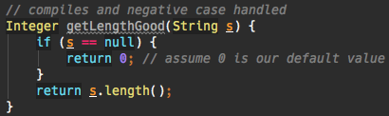
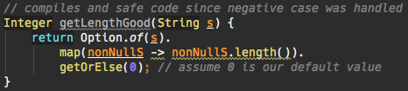
Example – Good Scenario
Imperative:
Functional:

Slide 9


Example – Bad Scenario
Imperative:
Functional:

Slide 10
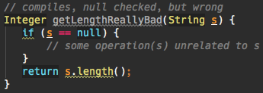
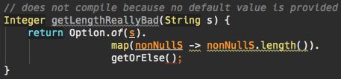
Example – Really Bad Scenario
Imperative:
Functional:

Slide 11
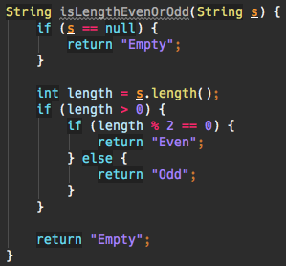
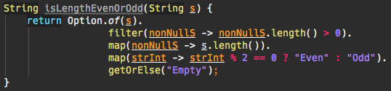
Example - Readability
Imperative:
Functional:

Slide 12
Next Time
List manipulation
Map
Reduce (Fold)
Filter
Map manipulation
Immutability
Fold
Try/Catch replacement
Returnable try/catch
Sane defaults

Slide 13
Questions

